Slide 1

Psychopharmacology: Drugs, the Brain, and Behavior
by Meyer, Farrar, Biezonski, Yates

Slide 2
Chapter 8
Glutamate and GABA
8.1 Glutamate Synthesis, Release, and Inactivation
8.2 Organization and Function of the Glutamatergic System
8.3 GABA Synthesis, Release, and Inactivation

Slide 3
Chapter 8
Learning Objectives (1 of 4)
8.1.1 Describe the processes by which glutamate is synthesized and metabolized and the interactions between glutamatergic neurons and astrocytes in these processes.
8.1.2 Name and describe the anatomical/cellular localization of the various glutamate vesicular transporters.
8.1.3 Name and describe (a) the anatomical/cellular localization of the excitatory amino acid transporters responsible for uptake from the extracellular fluid, and (b) the functional role of these transporters.

Slide 4
Chapter 8
Learning Objectives (2 of 4)
8.2.1 (a) Describe the structure (including subunit composition) and function of the three types of ionotropic glutamate receptors, and (b) list the major agonists and antagonists for these receptors, including whether a given antagonist is competitive or uncompetitive.
8.2.2 (a) Describe the features (including groupings) of the metabotropic glutamate receptors, and (b) discuss evidence for a role for mGluR5 in fragile X syndrome.
8.2.3 Discuss the properties of long-term potentiation (LTP), the role of glutamate receptors in LTP induction and expression, and the proposed relationship between LTP and learning and memory processes.
8.2.4 (a) Describe three types of cell death in the brain, (b) the mechanisms of cell death by glutamate excitoxicity, and (c) how excitotoxic cell death may contribute to several nervous system disorders.

Slide 5
Chapter 8
Learning Objectives (3 of 4)
8.3.1 (a) Identify the biochemical pathways by which GABA is synthesized and metabolized, and (b) name and discuss the clinical use of a drug that blocks GABA breakdown.
8.3.2 (a) Describe the functions and localization of the GABA transporters that mediate vesicular GABA uptake and removal of GABA from the extracellular fluid after its release, and (b) name and discuss the clinical use of a drug that blocks GABA reuptake.
8.3.3 Discuss the characteristics of GABA co-expression and co-release with other neurotransmitters.

Slide 6
Chapter 8
Learning Objectives (4 of 4)
8.4.1 Describe use of GABA as a neurotransmitter both in local inhibitory interneurons and in projection neurons.
8.4.2 (a) Describe the subunit composition and electrophysiological properties of ionotropic GABAA receptors, (b) name the major drugs that act as agonists or antagonists of these receptors, and (c) discuss the classes of drugs that act as GABAA receptor positive allosteric modulators and the clinical applications of such drugs where appropriate.
8.4.3 Discuss evidence for a role for GABA and the GABAA receptor in epilepsy.
8.4.4 Describe the structure, signaling mechanisms, and functional roles of metabotropic GABAB receptors.

Slide 7
Glutamate Synthesis, Release, and Inactivation (1 of 6)
Glutamate Synthesis, Release, and Inactivation
Glutamate: ionized form of glutamic acid (an amino acid); formed from glutamine by glutaminase
Glutamate and aspartate are excitatory amino acid neurotransmitters.
Glutamatergic neurons use glutamate as the transmitter.
Glutamate is in all cells because of its multiple biochemical functions but glutamatergic neurons have higher concentrations and segregate their neurotransmitter pool.
Notes:
Instructor Notes:

Slide 8
Glutamate Synthesis, Release, and Inactivation (2 of 6)
Glutamate packaging into vesicles and uptake after release are mediated by multiple transport systems
Vesicular glutamate transporters move glutamate into synaptic vesicles: VGLUT1, VGLUT2, VGLUT3; found only in glutamatergic neurons
In some neurons, these transporters are expressed with markers for 5-HT, DA, ACh, or GABA, indicating that glutamate is a cotransmitter
DA–glutamate co-expressing neurons of the VTA release the two transmitters from separate vesicles at different kinds of axon terminals
Notes:
Instructor Notes:
VTA: ventral tegmental area

Slide 9
Glutamate Synthesis, Release, and Inactivation (3 of 6)
Glutamate packaging into vesicles and uptake after release are mediated by multiple transport systems
Glutamate uptake: 5 different excitatory amino acid transporters (EAATs) occur in different locations
Astrocytes express EAAT2 and may account for about 90% of total glutamate uptake in the brain
High levels of extracellular glutamate are dangerous; EAAT2 knockout mice develop seizures and have short life spans.
Notes:
Instructor Notes:

Slide 10
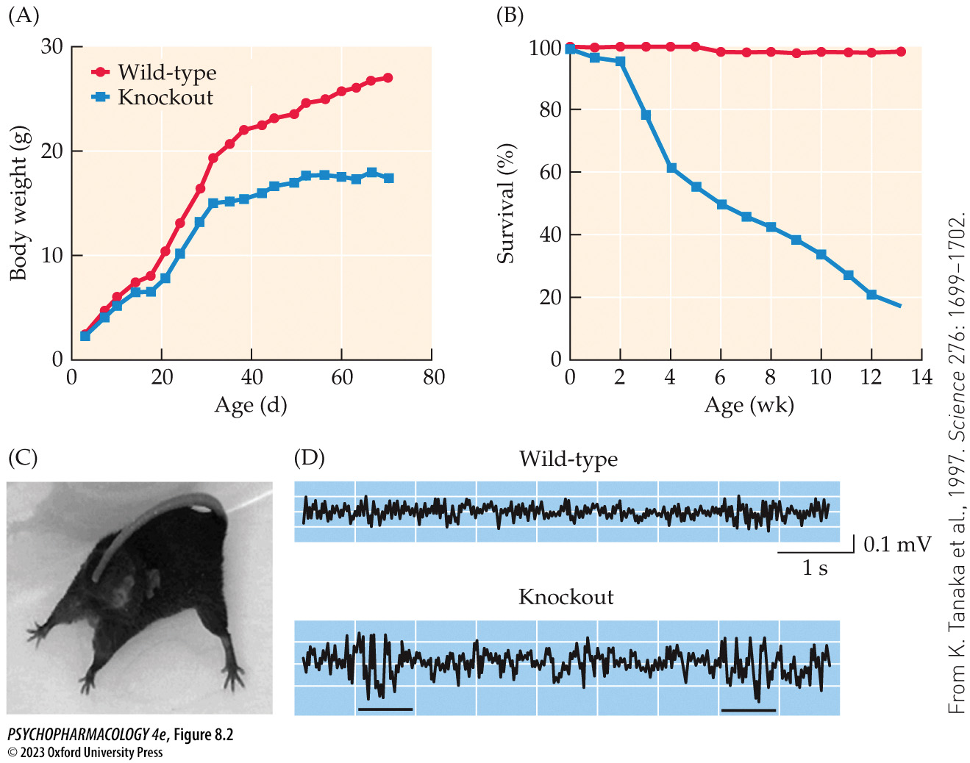
FIGURE 8.2 Phenotypic charac­teristics of mutant mice lacking EAAT2
Notes:
FIGURE 8.2 Phenotypic charac­teristics of mutant mice lacking EAAT2
(A) EAAT2 knockout mice exhibited a reduction in weight gain compared with genetically normal wild-type mice, particularly once they reached 30 days of age. (B) The knockout mice showed increased mortality beginning at 3 weeks of age. (C) and (D) Mice lacking EAAT2 had increased brain excitability that manifested as spontaneous behavioral seizures (note the abnormal posture in C, which is caused by epileptic activity in the brain) and seizure-like EEG changes (underlined traces in D) when given a sub­threshold dose of the convulsant agent pentylenetetrazole. Note that at this drug dose, the wild-type mice showed no such EEG changes. (From K. Tanaka et al., 1997. Science 276: 1699–1702.)

Slide 11
Glutamate Synthesis, Release, and Inactivation (4 of 6)
Glutamate packaging into vesicles and uptake after release are mediated by multiple transport systems
EAAT1: highly expressed in astrocytes in the cerebellum
EAAT3: major neuronal glutamate transporter; postsynaptic localization
EAAT4: expressed primarily by Purkinje cells in the cerebellum
EAAT5: present in bipolar cells in the retina.
Notes:
Instructor Notes:

Slide 12
Glutamate Synthesis, Release, and Inactivation (5 of 6)
Glutamate packaging into vesicles and uptake after release are mediated by multiple transport systems
Astrocyte transporters convert the glutamate they take up to glutamine using glutamine synthetase
Glutamine is then transported out of astrocytes and picked up by neurons, where it can be converted back into glutamate by glutaminase
Glutamine synthetase also helps in the metabolism and removal of ammonia
Notes:
Instructor Notes:

Slide 13
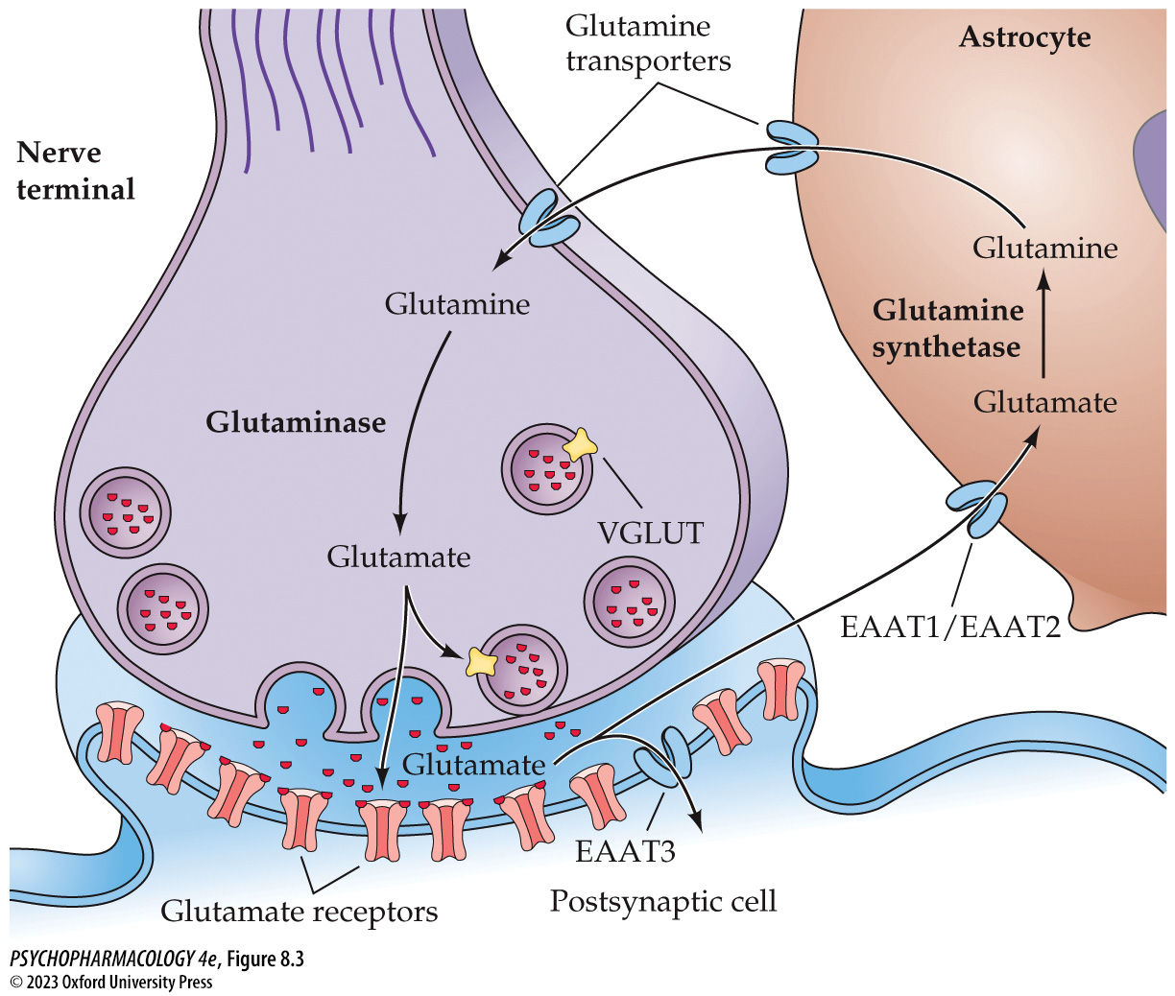
FIGURE 8.3 Cycling of glutamate and glutamine between glutamatergic neurons and astrocytes
Notes:
FIGURE 8.3 Cycling of glutamate and glutamine between glutamatergic neurons and astrocytes
After neurons release glutamate, it can be transported into nearby astrocytes by EAAT1 or EAAT2, or less commonly it can be transported into the postsynaptic cell by EAAT3. Inside the astrocyte, glutamate is converted into glutamine by the enzyme glutamine synthetase. The glutamine can be later released by the astrocytes, taken up by neurons, and converted back into glutamate by the enzyme glutaminase.

Slide 14
Glutamate Synthesis, Release, and Inactivation (6 of 6)
CLICKER QUESTION 1
What is the role of astrocytes in the glutamatergic system?
They break down glutamate into aspartate.
They “recycle” glutamate by converting it to glutamine.
They synthesize vesicular glutamate transporters.
Notes:
Instructor Notes:
Correct answer: b

Slide 15
Review of Learning Objectives (1 of 4)
8.1.1 Describe the processes by which glutamate is synthesized and metabolized and the interactions between glutamatergic neurons and astrocytes in these processes.
8.1.2 Name and describe the anatomical/cellular localization of the various glutamate vesicular transporters.
8.1.3 Name and describe (a) the anatomical/cellular localization of the excitatory amino acid transporters responsible for uptake from the extracellular fluid, and (b) the functional role of these transporters.

Slide 16
Organization and Function of the Glutamatergic System
(1 of 14)
Glutamate is the neurotransmitter used in many excitatory pathways in the brain
Glutamatergic pathways in the brain include
  Projections of the pyramidal neurons of the cortex
  Parallel fibers of the cerebrum
  Excitatory pathways in the hippocampus
Glutamate is found throughout the brain; important functions include synaptic plasticity, learning and memory, possibly in psychopathologic disorders
Notes:
Instructor Notes:

Slide 17
Organization and Function of the Glutamatergic System
(2 of 14)
Both ionotropic and metabotropic receptors mediate the synaptic effects of glutamate
Ionotropic glutamate receptors depolarize the membrane of the postsynaptic cell (excitatory) (fast signaling):
  AMPA receptor, named for selective agonist AMPA; most fast excitatory responses to glutamate are mediated by stimulation of AMPA receptors
  Kainate receptor, named for selective agonist kainic acid
  NMDA receptor, named for the agonist NMDA; allows both Na+ and Ca2+ to pass; Ca2+ also activates a second messenger
Notes:
Instructor Notes:
AMPA (α-amino-3-hydroxy-5-methyl-4-isoxazole propionic acid) – a synthetic amino acid analog
Kainic acid comes from a type of seaweed called Digenea simplex
NMDA (N-methyld-aspartate), a synthetic amino acid

Slide 18
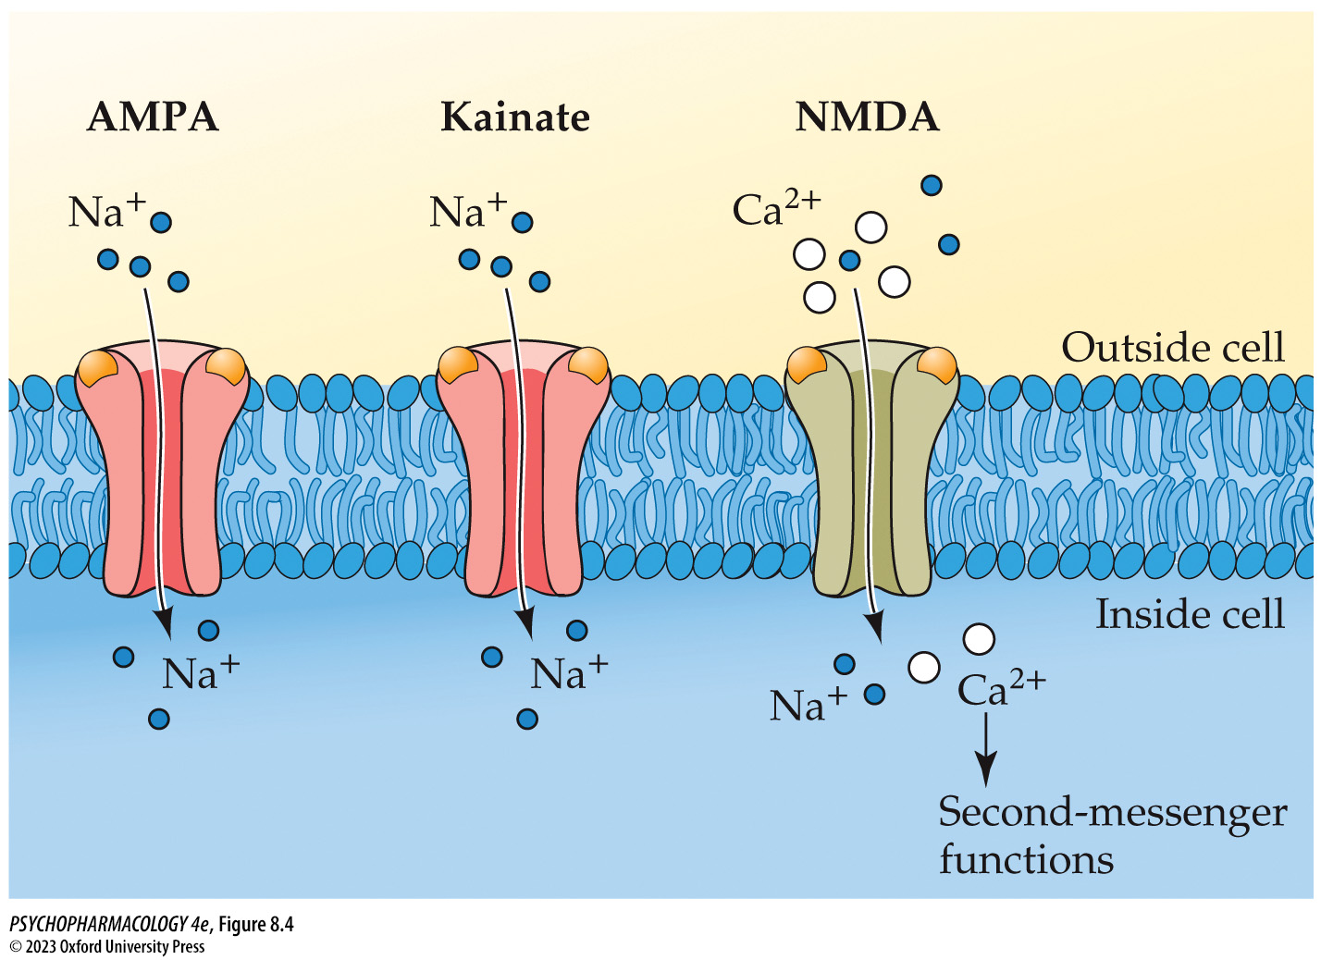
FIGURE 8.4 Ion permeabilities of ionotropic glutamate receptor channels
Notes:
FIGURE 8.4 Ion permeabilities of ionotropic glutamate receptor channels
All three ionotropic glutamate receptor channels conduct Na⁺ ions into the cell. NMDA receptor channels additionally conduct Ca²⁺ ions, which can activate several important second-messenger functions.

Slide 19
Organization and Function of the Glutamatergic System
(3 of 14)
Both ionotropic and metabotropic receptors mediate the synaptic effects of glutamate
Ionotropic glutamate receptors have 4 subunits; each subtype is composed of a different set of subunits
Antagonist NBQX blocks AMPA and kainate receptors but not NMDA receptors.
In mice, NBXQ leads to sedation, ataxia, reduced locomotor activity, deficient rotarod performance, and protection against seizures
Notes:
Instructor Notes:
See table 8.1
NBQX [6-nitro7-sulfamoyl-benzo(f)quinoxaline-2,3-dione]
Experiments on mice indicate AMPA receptor involvement in locomotor activity, coordination, and brain excitability

Slide 20
Organization and Function of the Glutamatergic System
(4 of 14)
Both ionotropic and metabotropic receptors mediate the synaptic effects of glutamate
NMDA receptors have unique characteristics:
  Flow of both Na⁺ and Ca²⁺
  Activated by simultaneous binding of glutamate and a co-agonist: glycine or D-serine (coincidence detection)
  Binding site for Mg²⁺ in the ion channel; blocks channel at resting potential; dissociates during depolarization and opens channel
Notes:
Instructor Notes:

Slide 21
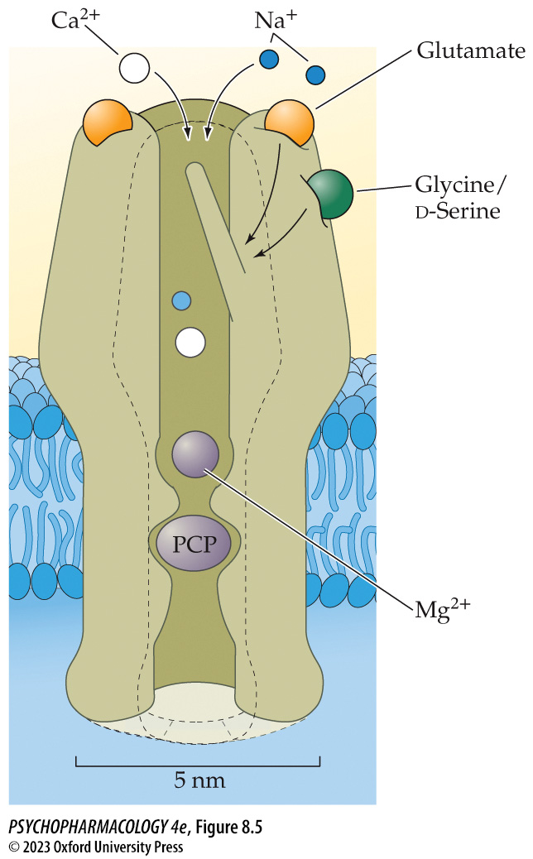
FIGURE 8.5 NMDA receptor properties
Notes:
FIGURE 8.5 NMDA receptor properties
The NMDA receptor is activated by simultaneous binding of glutamate and a co-agonist, either glycine or d-serine. Note that the locations of the glutamate and glycine binding sites are highly stylized and are not meant to accurately depict the locations of the actual sites shown in Figure 8.6. The diagram further illustrates that the receptor channel can be blocked by Mg²⁺ ions under resting conditions and also by the presence of the abused drug phencyclidine (PCP).

Slide 22
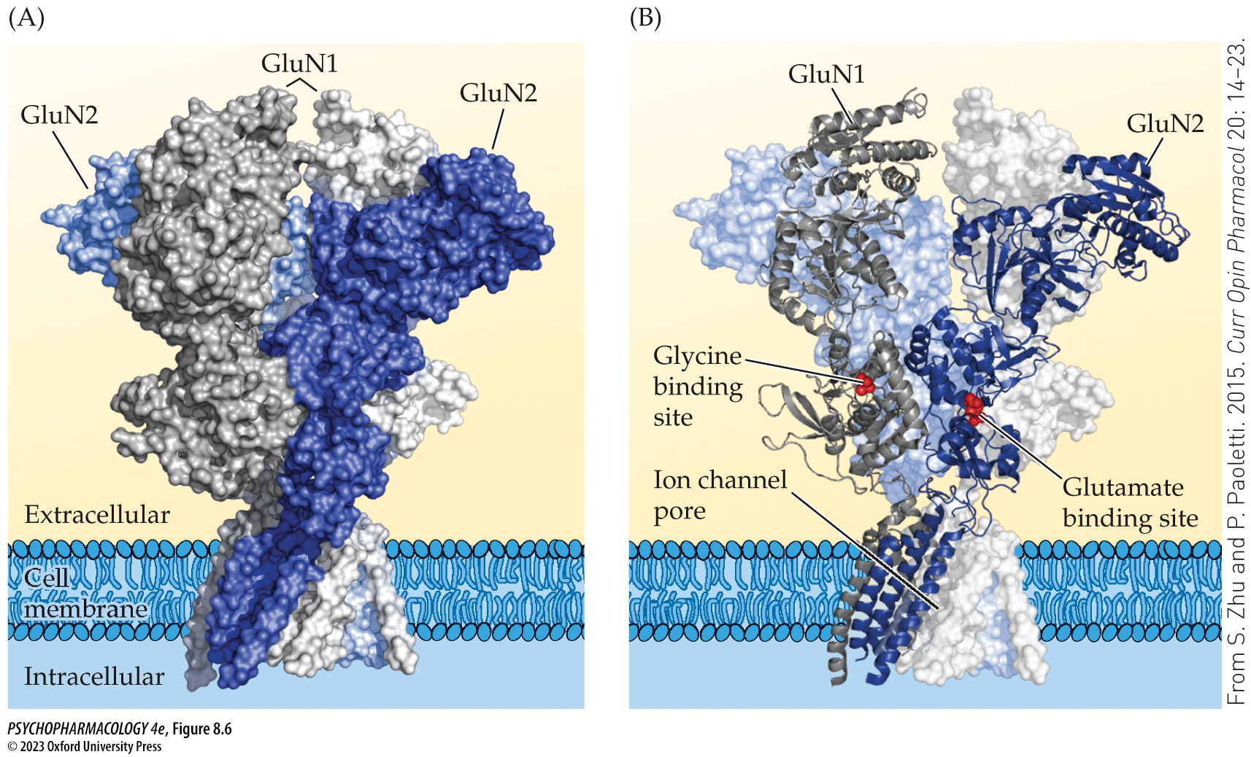
FIGURE 8.6 Three-dimensional depiction of an NMDA receptor in the cell membrane
Notes:
FIGURE 8.6 Three-dimensional depiction of an NMDA receptor in the cell membrane
(A) The receptor is composed of two GluN1 subunits (shown in shades of gray) and two GluN2 subunits (shown in shades of blue). (B) A cutaway view of the receptor with a molecule of glycine bound to a GluN1 subunit and a molecule of glutamate bound to a GluN2 subunit. Both agonists are shown in red. This view shows regions of the two subunits that are predicted to have a ribbon structure (wavy lines) and other regions that are predicted to have a helical structure (lines in a corkscrew configuration). Note that the ion channel pore is shown in the closed state. (From S. Zhu and P. Paoletti. 2015. Curr Opin Pharmacol 20: 14–23. © 2014. Reprinted with permission from Elsevier.)

Slide 23
Organization and Function of the Glutamatergic System
(5 of 14)
Both ionotropic and metabotropic receptors mediate the synaptic effects of glutamate
Second binding site in the channel recognizes NMDA receptor antagonists that block the channel:
  Abused drugs phencyclidine (PCP) and ketamine
  MK-801 (dizocilpine) used for research
  Memantine (Namenda) used to treat Alzheimer’s disease
These drugs are uncompetitive antagonists: require the receptor to be activated (open) by an agonist
Notes:
Instructor Notes:

Slide 24
Organization and Function of the Glutamatergic System
(6 of 14)
Both ionotropic and metabotropic receptors mediate the synaptic effects of glutamate
Metabotropic glutamate receptors: mGluR1 to mGluR8
  Group I (mGluR1 and mGluR5) – located postsynaptically; use the phosphoinositide second-messenger system
  Group II (mGluR2 and mGluR3)
  Group III (mGluR4 and mGluR6–8) – located presynaptically; reduce transmitter release by inhibiting cAMP formation
l-AP4: selective agonist at group III glutamate autoreceptors; suppresses transmission
Notes:
Instructor Notes:
l-AP4 (l-2-amino-4-phosphonobutyrate)

Slide 25
Organization and Function of the Glutamatergic System
(7 of 14)
BOX 8.1 CLINICAL APPLICATIONS
Fragile X Syndrome and Metabotropic Glutamate Receptor Antagonists: A Contemporary Saga of Translational Medicine
Fragile X syndrome is caused by mutations in the FMR1 gene on the X chromosome.
Metabotropic glutamate receptor theory: loss of FMRP causes exaggerated group I mGluR–related functions, leading to dendritic spine abnormalities and elevated rates of LTD.
An mGluR5 antagonist, mavoglurant, was developed that worked as predicted in Fmr1-knockout mice, but not in trials with human patients.
Notes:
Instructor Notes:
FMR1: fragile X mental retardation 1 gene; codes for fragile X mental retardation protein (FMRP)
Long-term depression (LTD) – a form of plasticity in the hippocampus. FMRP restricts the LTD process.
LTD weakens neurotransmission at the affected synapses. A specific type of LTD is activated by the group I metabotropic glutamate receptors.

Slide 26
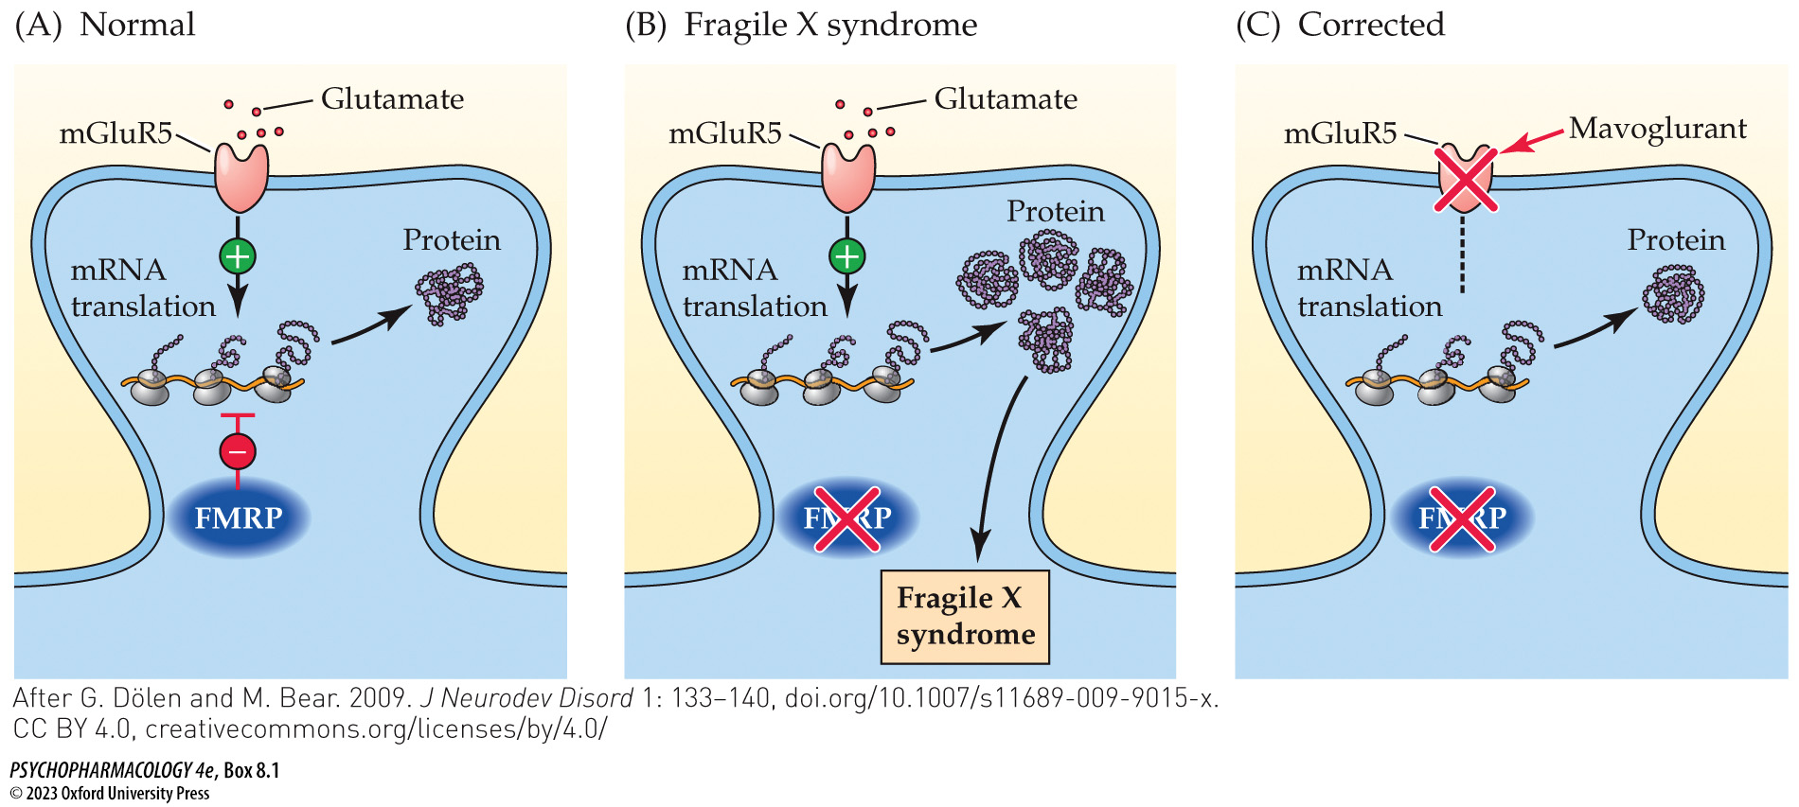
Box 8.1 Clinical Applications: Fragile X Syndrome and Metabotropic Glutamate Receptor Antagonists: A Contemporary Saga of Translational Medicine
Notes:
Box 8.1 Clinical Applications: Fragile X Syndrome and Metabotropic Glutamate Receptor Antagonists: A Contemporary Saga of Translational Medicine
mGluR5, FMRP, and synaptic plasticity in health and in fragile X syndrome
(A) In a normal healthy brain, the presence of FMRP regulates postsynaptic mRNA translation and synaptic plasticity in response to activation of mGluR5 and other neurotransmitter receptors. (B) Loss of FMRP in fragile X syndrome causes excessive mRNA translation, increased long-term depression, and abnormal dendritic structure. (C) Blockade of mGluR5 by mavoglurant is hypothesized to at least partially reverse the effects of FMRP loss, potentially leading to normalization of synaptic structure and plasticity. (After G. Dölen and M. Bear. 2009. J Neurodev Disord 1: 133–140, doi.org/10.1007/s11689-009-9015-x. CC BY 4.0, creativecommons.org/licenses/by/4.0/)

Slide 27
Organization and Function of the Glutamatergic System
(8 of 14)
AMPA and NMDA receptors play a key role in learning and memory
Positive allosteric modulators of AMPA may be cognitive enhancers; most reduce the rate of receptor deactivation – glutamate can exert a more prolonged excitatory effect
AMPA receptor positive allosteric modulators have been shown to enhance learning and memory in experimental animals but not in clinical trials.
Notes:
Instructor Notes:

Slide 28
Organization and Function of the Glutamatergic System
(9 of 14)
AMPA and NMDA receptors play a key role in learning and memory
One aspect of long-term potentiation (LTP): the coincidence detector feature of NMDA receptors
In associative learning, repeated pairings of the CS and the US theoretically strengthen the synaptic connections between the CS input neurons and the postsynaptic cells; the latter cells (which express NMDA receptors) are being depolarized at the same time that the nerve terminals of the CS neurons are releasing glutamate.
Notes:
Instructor Notes:
Long-term potentiation (LTP): long lasting synaptic strengthening
CS = conditioned stimulus, US = unconditioned stimulus

Slide 29
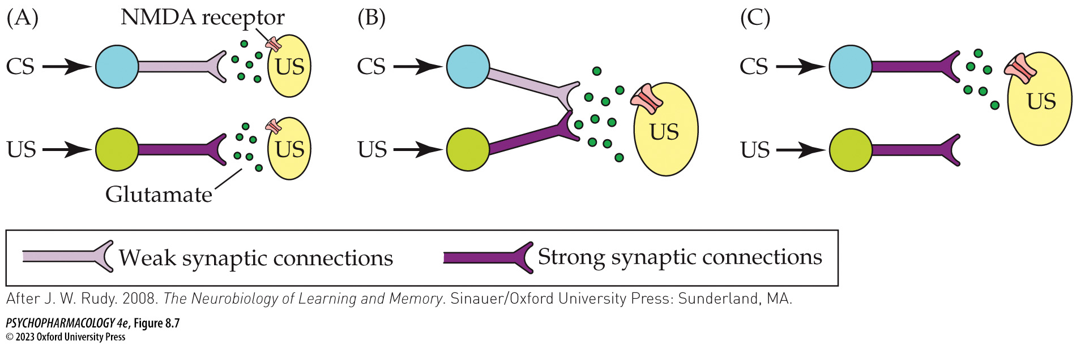
FIGURE 8.7 A hypothesized role for NMDA receptors in associative learning
Notes:
FIGURE 8.7 A hypothesized role for NMDA receptors in associative learning
CS, conditioned stimulus; US, unconditioned stimulus (After J. W. Rudy. 2008. The Neurobiology of Learning and Memory. Sinauer/Oxford University Press: Sunderland, MA.)

Slide 30
Organization and Function of the Glutamatergic System
(10 of 14)
AMPA and NMDA receptors play a key role in learning and memory
Long-term potentiation (LTP): persistent increase in synaptic strength produced by a burst of activity in the presynaptic neuron; experimentally produced by tetanic stimulus
CA1 hippocampal LTP: early LTP (E-LTP) lasts a few hours; late LTP (L-LTP) lasts days or months
E-LTP is studied using hippocampal slices; activation of NMDA receptor is necessary for induction of hippocampal LTP
Notes:
Instructor Notes:

Slide 31
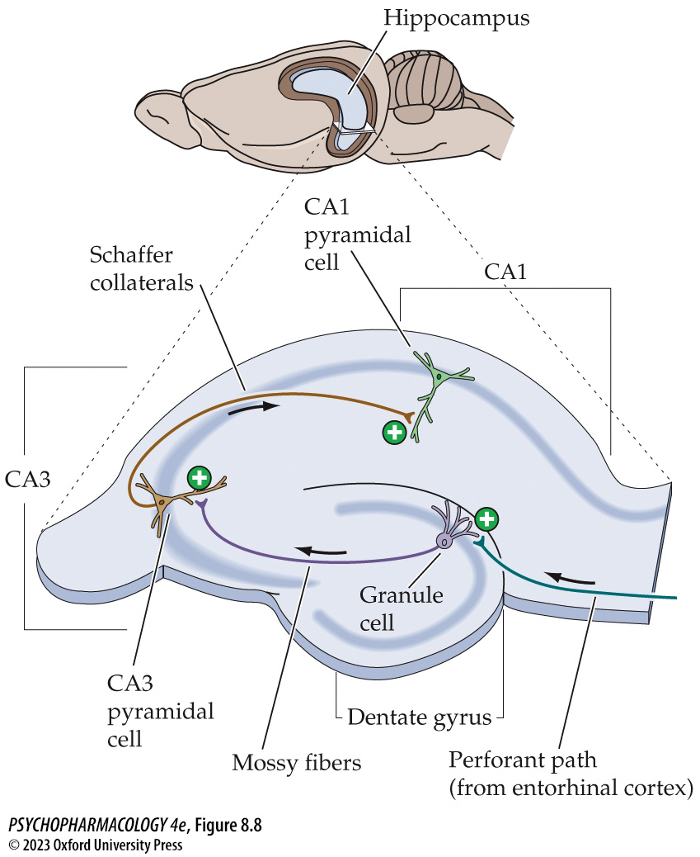
FIGURE 8.8 Long-term potentiation of synaptic transmission
Notes:
FIGURE 8.8 Long-term potentiation of synaptic transmission
LTP can be studied in vitro using the hippo­campal slice preparation.

Slide 32
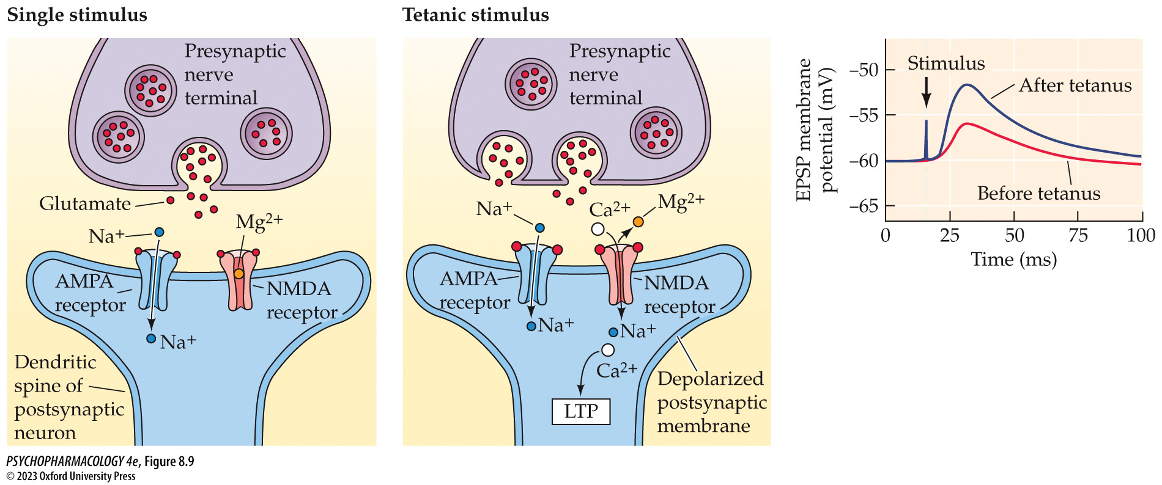
FIGURE 8.9 Induction of long-term potentiation
Notes:
FIGURE 8.9 Induction of long-term potentiation
LTP is induced by a tetanic stimulation of the presynaptic input.

Slide 33
Organization and Function of the Glutamatergic System
(11 of 14)
AMPA and NMDA receptors play a key role in learning and memory
E-LTP induction phase: during and immediately after tetanic stimulation; NMDA receptors have a critical role
Expression phase: the resulting increase in synaptic strength can be measured
Postsynaptic Ca²⁺ influx and CaMKII activation cause rapid expansion of dendritic spines and insertion of more AMPA receptors into the spine membrane – a form of receptor trafficking
E-LTP converts silent synapses (NMDA receptors only) to functional by trafficking AMPA receptors into the spine
Notes:
Instructor Notes:

Slide 34
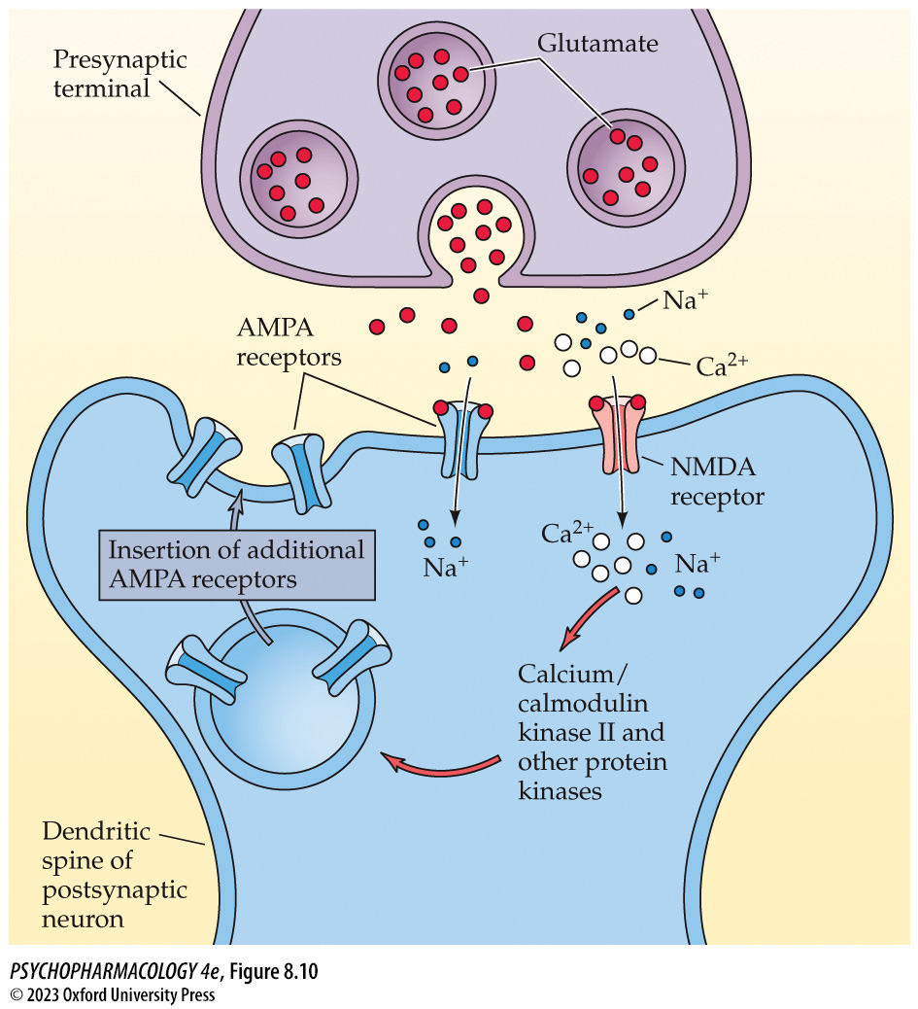
FIGURE 8.10 The underlying mechanism
Notes:
FIGURE 8.10 The underlying mechanism
LTP involves modification of AMPA receptors in the postsynaptic cell.

Slide 35
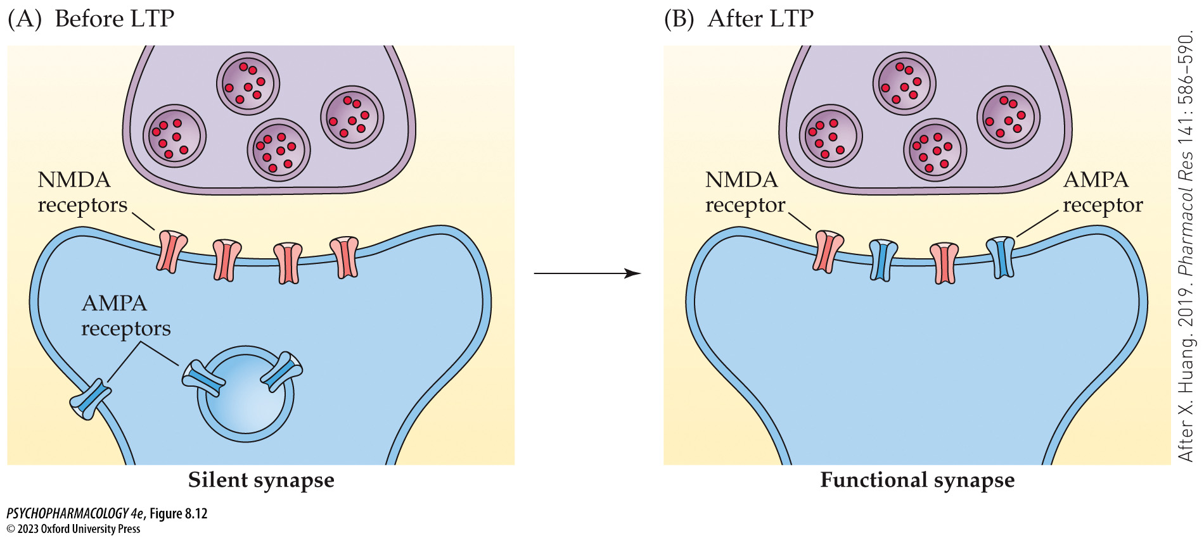
FIGURE 8.12 Conversion of a silent to a functional synapse by LTP
Notes:
FIGURE 8.12 Conversion of a silent to a functional synapse by LTP
Some dendritic spines possess NMDA receptors in the membrane but lack AMPA receptors (left). The absence of AMPA receptors renders the spine unresponsive to normal low levels of glutamate release (i.e., the synapse is “silent”). However, LTP applied to nearby spine synapses causes trafficking of internal AMPA receptors into the membrane of the silent synapse, thereby rendering it functional (right). (After X. Huang. 2019. Pharmacol Res 141: 586–590.)

Slide 36
Organization and Function of the Glutamatergic System
(12 of 14)
High levels of glutamate can be toxic to nerve cells
Excitotoxicity hypothesis: excessive exposure to glutamate causes prolonged depolarization of receptive neurons that leads to their damage or death.
Excitotoxic lesions are selective: kills nerve cells but spares fibers of passage
Cell death can occur by necrosis, characterized by lysis, or by programmed cell death (apoptosis or necroptosis)
Notes:
Instructor Notes:
Lysis (bursting) of the cell due to osmotic swelling

Slide 37
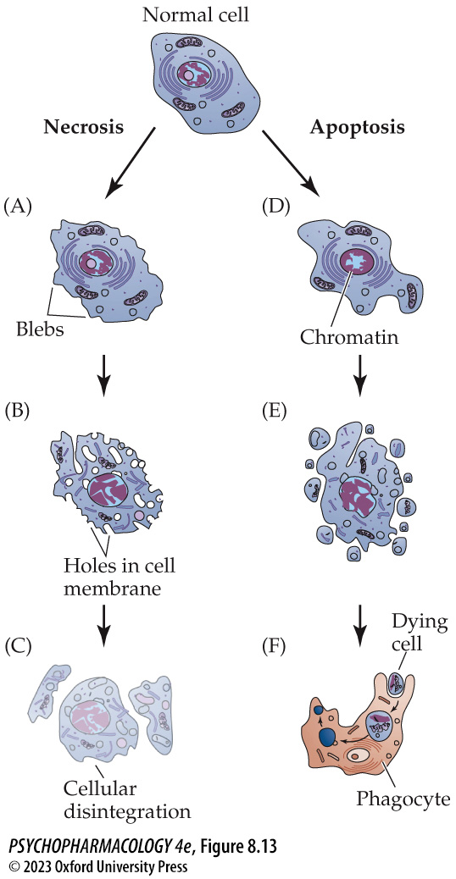
FIGURE 8.13 Cell death by necrosis versus apoptosis
Notes:
FIGURE 8.13 Cell death by necrosis versus apoptosis
During the initial stages of necrosis (A), the cell swells and the membrane forms protrusions called blebs. In the next stage (B), the membrane begins to break up and release the contents of the cell cytoplasm. Finally, the cell disintegrates completely (C). In apoptotic cell death, the cell also blebs (D), but instead of swelling, it shrinks. At the same time, the chromatin (genetic material) condenses within the cell nucleus. The cell then breaks up into smaller pieces (E) that are subsequently engulfed and digested by phagocytes (F).

Slide 38
Organization and Function of the Glutamatergic System
(13 of 14)
High levels of glutamate can be toxic to nerve cells
Monosodium glutamate (MSG) does not increase glutamate levels in the brain because it can’t cross the blood-brain barrier
In humans, excitotoxic cell death can be caused by food contaminated with the algal toxin domoic acid.
Excitotoxic cell death may contribute to brain damage that occurs with strokes and brain injuries, mediated by Ca²⁺ entry through extrasynaptic NMDA receptors containing GluN2B subunits.
Notes:
Instructor Notes:

Slide 39
Organization and Function of the Glutamatergic System
(14 of 14)
CLICKER QUESTION 2
Glycine and d-serine are co-agonists with glutamate at _______ receptors.
mGluR5
kianate
AMPA
NMDA
Notes:
Instructor Notes:
Correct answer: d

Slide 40
Review of Learning Objectives (2 of 4)
8.2.1 (a) Describe the structure (including subunit composition) and function of the three types of ionotropic glutamate receptors, and (b) list the major agonists and antagonists for these receptors, including whether a given antagonist is competitive or uncompetitive.
8.2.2 (a) Describe the features (including groupings) of the metabotropic glutamate receptors, and (b) discuss evidence for a role for mGluR5 in fragile X syndrome.
8.2.3 Discuss the properties of long-term potentiation (LTP), the role of glutamate receptors in LTP induction and expression, and the proposed relationship between LTP and learning and memory processes.
8.2.4 (a) Describe three types of cell death in the brain, (b) the mechanisms of cell death by glutamate excitoxicity, and (c) how excitotoxic cell death may contribute to several nervous system disorders.

Slide 41
GABA Synthesis, Release, and Inactivation (1 of 5)
GABA is synthesized by the enzyme glutamic acid decarboxylase
GABA (γ-aminobutyric acid) major inhibitory amino acid transmitter; manufactured only by GABAergic neurons; has a critical role in regulating brain excitability.
Synthesized from glutamate in one step by glutamic acid decarboxylase (GAD)
Allylglycine, thiosemicarbazide, and 3-mercaptopropionic acid can block GABA synthesis; can only be used for in vitro studies.
Notes:
Instructor Notes:

Slide 42
GABA Synthesis, Release, and Inactivation (2 of 5)
GABA packaging into vesicles and uptake after release are mediated by specific transporter proteins
Vesicular GABA transporters (VGAT) move GABA (and glycine) into vesicles.
GABA is removed from the synaptic cleft by transporters GAT-1 and GAT-2 (in neurons and astrocytes) and GAT-3 (only in astrocytes).
Tiagabine: selective inhibitor of GAT-1; elevates extracellular GABA levels and enhances GABAergic transmission in several brain areas; marketed as Gabitril for treating epilepsy
Notes:
Instructor Notes:
VGAT also called VIAAT (vesicular inhibitory amino acid transporters) because they also transport glycine -another inhibitory amino acid transmitter

Slide 43
GABA Synthesis, Release, and Inactivation (3 of 5)
GABA packaging into vesicles and uptake after release are mediated by specific transporter proteins
GABA is metabolized to glutamate and succinate by GABA aminotransferase (GABA-T), in neurons and astrocytes.
In astrocytes, the glutamate is converted to glutamine by glutamine synthetase.
Glutamine can be released by astrocytes, taken up by neurons, converted back to glutamate, and used to remake GABA.
Notes:
Instructor Notes:

Slide 44
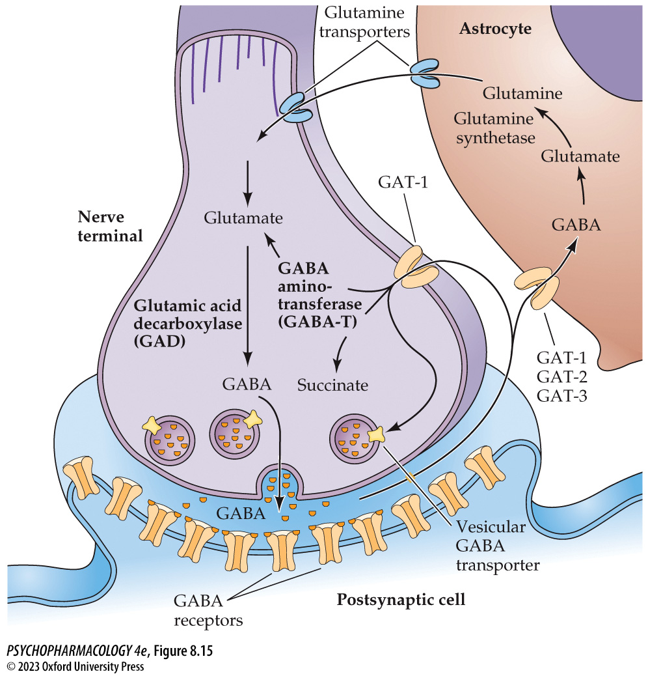
FIGURE 8.15 Cycling of GABA between GABAergic neurons and astrocytes
Notes:
FIGURE 8.15 Cycling of GABA between GABAergic neurons and astrocytes
After neurons release GABA, it can be transported back into the nerve terminal by GAT-1 or transported into nearby astrocytes by GAT-2 or GAT-3. Inside the cell, GABA is metabolized to glutamate and succinate by GABA aminotransferase (GABA-T). In the case of astrocytes, the glutamate is converted into glutamine by the enzyme glutamine synthetase. The glutamine can later be released by the astrocytes, taken up by neurons, converted back into glutamate by the enzyme glutaminase, and finally used to resynthesize GABA.

Slide 45
GABA Synthesis, Release, and Inactivation (4 of 5)
GABA is co-released with several other classical neurotransmitters
Co-release of GABA has been demonstrated for neurons that also use glycine, ACh, DA, or glutamate
In some cases there is co-expression of the vesicular transporters for multiple transmitters in the same neuron.
Some neurons co-release GABA (inhibitory) and glutamate (excitatory) at the same time; allows for fine-tuning of the postsynaptic response.
Notes:
Instructor Notes:

Slide 46
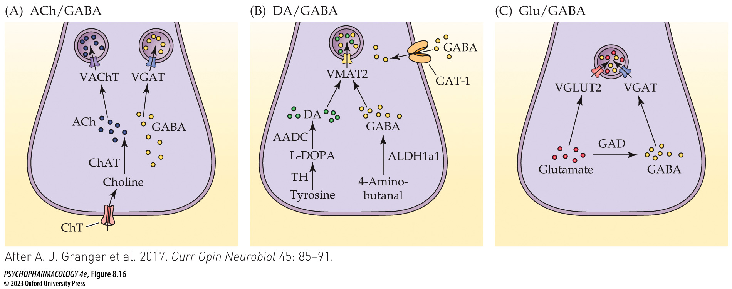
FIGURE 8.16 Examples of co-transmission of GABA with other neurotransmitters
Notes:
FIGURE 8.16 Examples of co-transmission of GABA with other neurotransmitters
(A) Basal forebrain cholinergic neurons additionally synthesize GABA. In the projections of these cells to the hippocampus, ACh and GABA are taken up and stored in separate vesicle populations. (B) Midbrain dopaminergic neurons can accumulate GABA either through GAT-1-mediated uptake or from 4-amino-butanal by an usual biosynthetic pathway. DA and GABA are taken up into the same synaptic vesicles by VMAT2. (C) Neurons of the entopeduncular nucleus that project to the lateral habenula synthesize both glutamate and GABA, and the two transmitters are taken up into the same synaptic vesicles by their respective vesicular transporters, VGLUT2 and VGAT. (After A. J. Granger et al. 2017. Curr Opin Neurobiol 45: 85–91.)

Slide 47
GABA Synthesis, Release, and Inactivation (5 of 5)
CLICKER QUESTION 3
A neuron that co-releases GABA and glycine would contain which of these chemicals?
VGAT
VMAT
VGAT + VGLUT2
VGLUT2 + VAChT
Notes:
Instructor Notes:
Correct answer: a

Slide 48
Chapter 8 Learning Objectives (3 of 4)
8.3.1 (a) Identify the biochemical pathways by which GABA is synthesized and metabolized, and (b) name and discuss the clinical use of a drug that blocks GABA breakdown.
8.3.2 (a) Describe the functions and localization of the GABA transporters that mediate vesicular GABA uptake and removal of GABA from the extracellular fluid after its release, and (b) name and discuss the clinical use of a drug that blocks GABA reuptake.
8.3.3 Discuss the characteristics of GABA co-expression and co-release with other neurotransmitters.

Slide 49
Organization and Function of the GABAergic System (1 of 9)
Some GABAergic neurons are interneurons, while others are projection neurons
Many brain areas are rich in GABA
  Cortex and hippocampus: GABAergic neurons are interneurons
  Striatum and cerebellar Purkinje cells: projection neurons
Spinocerebellar ataxias: rare genetic mutations that cause degeneration and death of Purkinje cells; causes ataxia, impaired balance and poor motor coordination.
Notes:
Instructor Notes:

Slide 50
Organization and Function of the GABAergic System (2 of 9)
The actions of GABA are primarily mediated by ionotropic GABA_{A} receptors
GABA_{A} receptor—ionotropic; GABA_{B} receptor—metabotropic
Each receptor is composed of five subunits, usually two α subunits, two βs, and one γ.
GABA_{A} channel allows Cl– to move in, causing hyperpolarization and inhibition of the postsynaptic cell.
Notes:
Instructor Notes:

Slide 51
Organization and Function of the GABAergic System (3 of 9)
The actions of GABA are primarily mediated by ionotropic GABA_{A} receptors
Muscimol: GABA_{A} agonist from the mushroom Amanita muscaria
Bicuculline: competitive antagonist for GABA_{A} receptors; blocks binding of GABA; if taken systemically, causes convulsions.
Pentylenetetrazol (Metrazol) and picrotoxin: convulsant drugs that inhibit GABA_{A} receptor function; act at sites distinct from the GABA binding site (noncompetitive antagonists)
Notes:
Instructor Notes:

Slide 52
Organization and Function of the GABAergic System (4 of 9)
The actions of GABA are primarily mediated by ionotropic GABA_{A} receptors
GABA_{A} receptors are sensitive to CNS-depressant drugs such as benzodiazepines (BDZs), barbiturates, and ethanol, which act as positive allosteric modulators – they enhance the action of GABA on the receptor
Other positive modulators:
  Anesthetics such as propofol (Diprivan)
  Neurosteroids
Notes:
Instructor Notes:

Slide 53
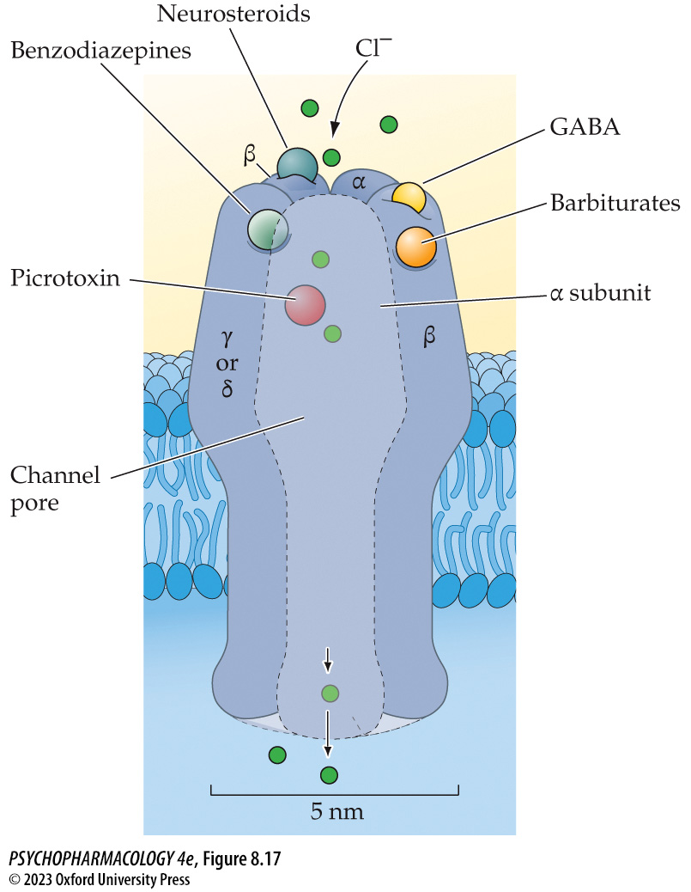
FIGURE 8.17 The GABA_{A} receptor
Notes:
FIGURE 8.17 The GABA_{A} receptor
The receptor consists of five subunits that form a Cl⁻-conducting channel. In addition to the GABA binding site on the receptor complex, there are additional modulatory sites for benzodiazepines, barbiturates, neurosteroids, and picrotoxin. Note that the locations of the various binding sites are depicted arbitrarily and are not meant to imply the actual locations of these sites on the receptor.

Slide 54
Organization and Function of the GABAergic System (5 of 9)
The actions of GABA are primarily mediated by ionotropic GABA_{A} receptors
BDZs and ethanol can only modulate receptor activity, regardless of dose; high doses of barbiturates, anesthetics, and neurosteroids can open the receptor channel even in the absence of GABA
BDZs such as diazepam (Valium) increase effect of GABA on a receptor; diazepam alone has no effect, confirming that BDZs are positive allosteric modulators and not receptor agonists
Inverse agonists at the BDZ receptor also require the presence of GABA, they reduce instead of enhance the effectiveness of GABA
Notes:
Instructor Notes:
Researchers have discovered several endogenous neuropeptides (endozepines, meaning endogenous BDZs) that allosterically modulate the GABA_{A} receptor by acting at the same site as BDZs.

Slide 55
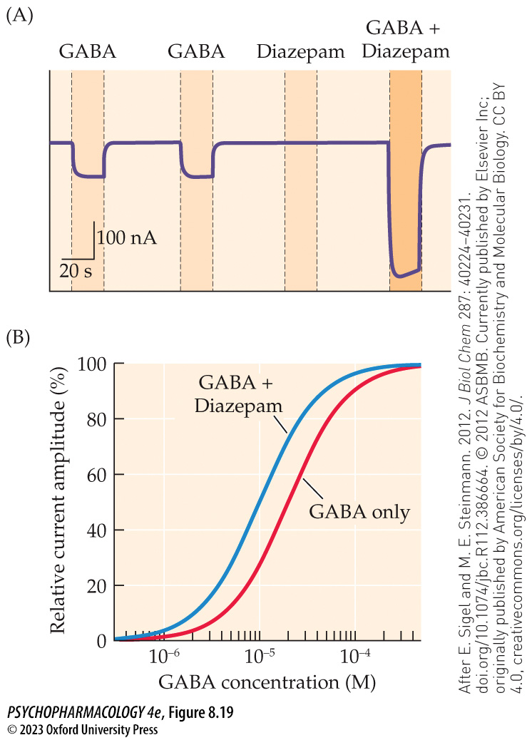
FIGURE 8.19 Positive allosteric modulation of the GABA_{A} receptor by diazepam
Notes:
FIGURE 8.19 Positive allosteric modulation of the GABA_{A} receptor by diazepam
(A) Downward traces depict inward current flow across the membrane of a GABA_{A} receptor–­expressing cell. Currents are elicited by application of a low concentration of GABA (left two traces). Application of diazepam (1 μM) by itself has no effect (third trace), but diazepam applied together with GABA elicits a large increase in current amplitude (rightmost trace). (B) The graph illustrates a concentration–response curve in the absence (red line) and presence (blue line) of a fixed concentration of diazepam. Note that the curve is shifted to the left in the presence of diazepam, indicating an enhancement of current amplitude in response to low to moderate concentrations of GABA. However, the maximum current amplitude elicited by a high concentration of GABA is unaffected by diazepam. (After E. Sigel and M. E. Steinmann. 2012. J Biol Chem 287: 40224–40231. doi.org/10.1074/jbc.R112.386664. © 2012 ASBMB. Currently published by Elsevier Inc; originally published by American Society for Biochemistry and Molecular Biology. CC BY 4.0, creativecommons.org/licenses/by/4.0/.)

Slide 56
Organization and Function of the GABAergic System (6 of 9)
The actions of GABA are primarily mediated by ionotropic GABA_{A} receptors
Anesthetics strongly enhance GABA_{A} receptor activity, usually as allosteric modulators
Anesthetics differentially affect receptors with particular subunit compositions
Neurosteroids: synthesized in the brain by neurons and glia, act as signaling molecules; target allosteric binding sites on GABA_{A} receptors
Notes:
Instructor Notes:

Slide 57
Organization and Function of the GABAergic System (7 of 9)
BOX 8.2 THE CUTTING EDGE
GABA_{A} Receptor Modulation by Neurosteroids
GABA_{A} receptor positive allosteric modulators ALLO, THDOC, and AS have sedating, anxiolytic, and anticonvulsant action
GABA_{A} receptor negative allosteric modulators PS and DHEAS result in opposite effects; but also positively modulate NMDA receptors
Studies indicate that neurosteroids, particularly ALLO, may be involved in catamenial epilepsy (heightened seizure susceptibility during the periovulatory or perimenstrual periods) and in postpartum depression.
Notes:
Instructor Notes:
ALLO: Allopregnanolone, THDOC: allotetrahydrodeoxycorticosterone. AS: androstanediol
PS: pregnenolone sulfate DHEAS: dehydroepiandrosterone sulfate

Slide 58
Organization and Function of the GABAergic System (8 of 9)
GABA also signals using metabotropic GABA_{B} receptors
Postsynaptic GABA_{B} receptors inhibit neuronal firing by stimulating K⁺ channel opening
Presynaptic GABA_{B} receptors (acting as autoreceptors or heteroreceptors) inhibit transmitter release by inhibiting Ca²⁺ channel opening.
Both inhibit adenylyl cyclase, reducing rate of cAMP formation
Baclofen (Lioresal): GABA_{B} agonist used as a muscle relaxant
Saclofen and 2-hydroxysaclofen are antagonists at GABA_{B} receptors
Notes:
Instructor Notes:

Slide 59
Organization and Function of the GABAergic System (9 of 9)
CLICKER QUESTION 4
Which of the following is a positive allosteric modulator of the GABA_{A} receptor?
Bicuculline
Muscimol
BDZ
Notes:
Instructor Notes:
Correct answer: c

Slide 60
Review of Learning Objectives (4 of 4)
8.4.1 Describe use of GABA as a neurotransmitter both in local inhibitory interneurons and in projection neurons.
8.4.2 (a) Describe the subunit composition and electrophysiological properties of ionotropic GABAA receptors, (b) name the major drugs that act as agonists or antagonists of these receptors, and (c) discuss the classes of drugs that act as GABAA receptor positive allosteric modulators and the clinical applications of such drugs where appropriate.
8.4.3 Discuss evidence for a role for GABA and the GABAA receptor in epilepsy.
8.4.4 Describe the structure, signaling mechanisms, and functional roles of metabotropic GABAB receptors.

